Slide 1
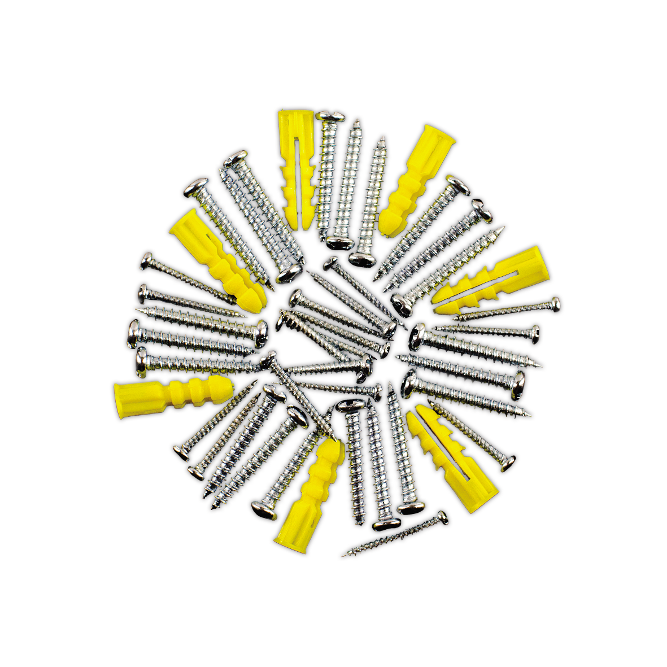
Microservices from the ground up
Systems Engineering

Slide 2
Agenda
Docker
Kubernetes
Terraform
Microservices
Container Orchestration
Cloud providers

Slide 3
Microservices
Order Pizza
Make Pizza
Focused purpose
Stateless
Elastic
Order pizza
Make pizza
Order pizza
Order pizza
Order pizza
Order pizza

Slide 4


Kubernetes cluster
Worker
Pod
Api
Service
Worker
Pod
HTTP
Pod
Client
AQMP
Worker
AQMP
Pod
RabbitMQ

Slide 5
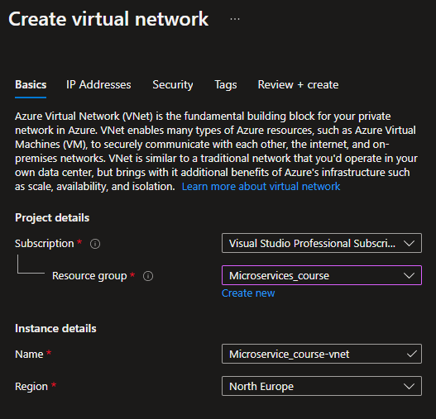
Terraform – Instead of using the GUI

Slide 6
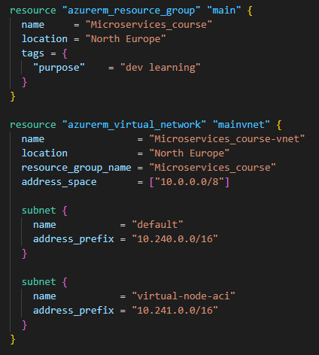
Terraform – Instead of using the GUI

Slide 7
Terraform – Instead of using the GUI

Slide 8
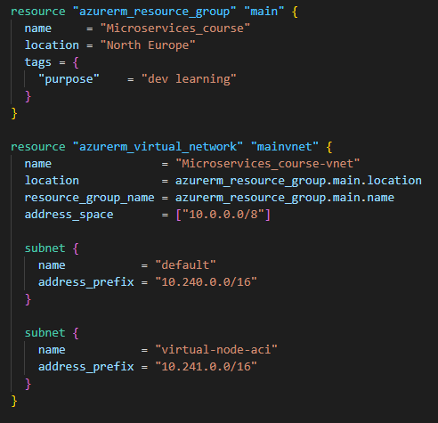
Terraform – Instead of using the GUI

